Slide 1
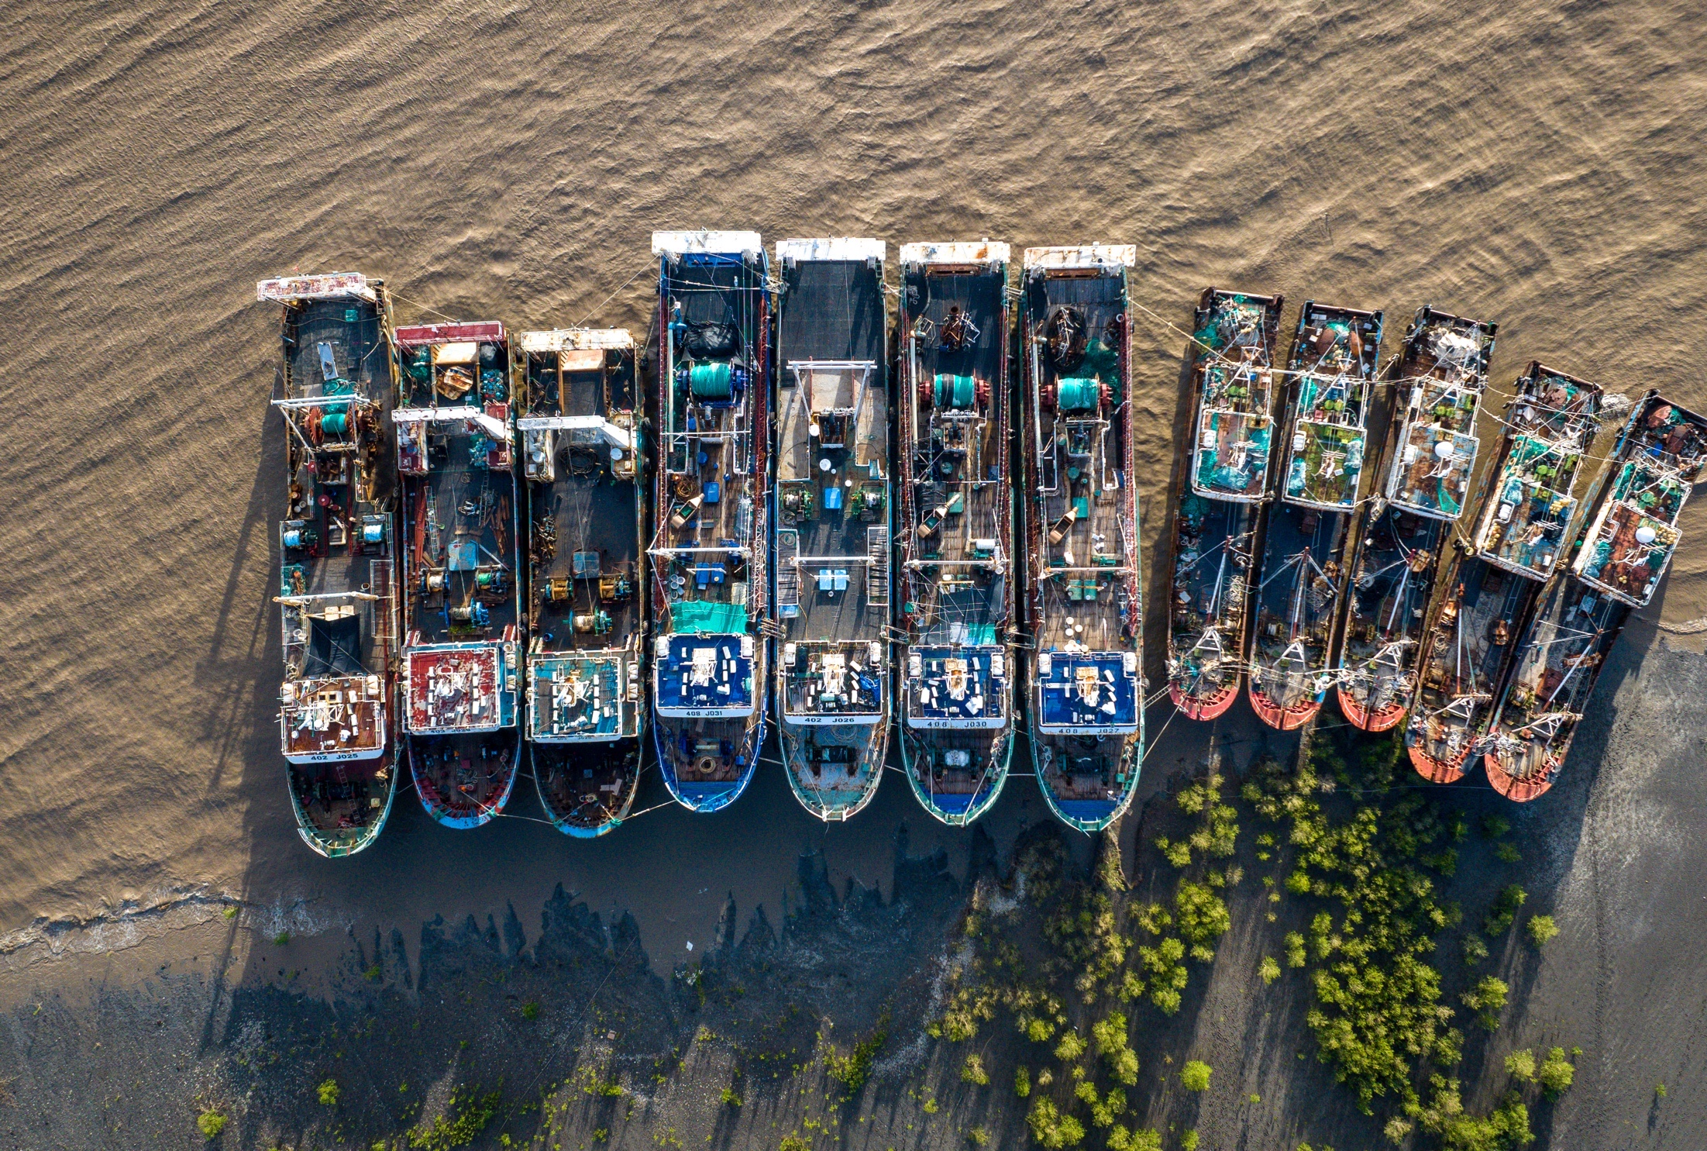
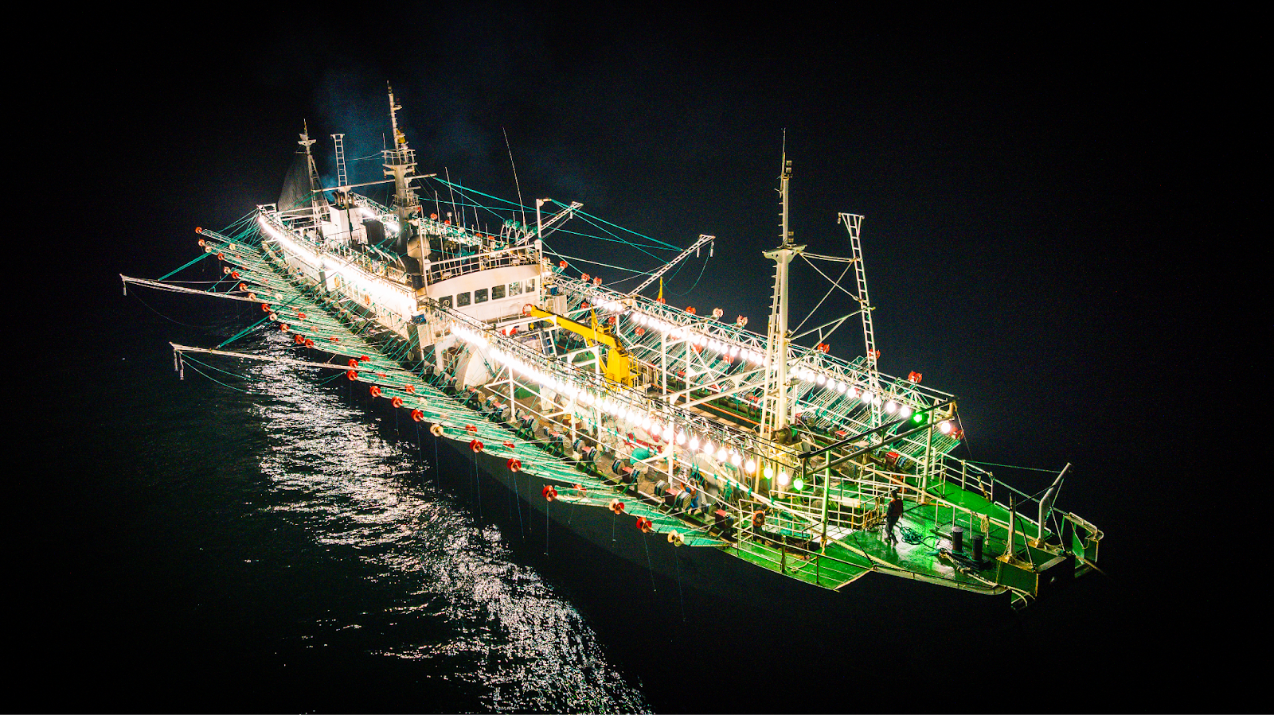
unregulated squid fisheries and associated abuses: the case of the southwest Atlantic October 2025 – Brussels
Chinese-owned fishing vessels in Mozambique
Notes:
Intro and thanks remarks

Slide 2

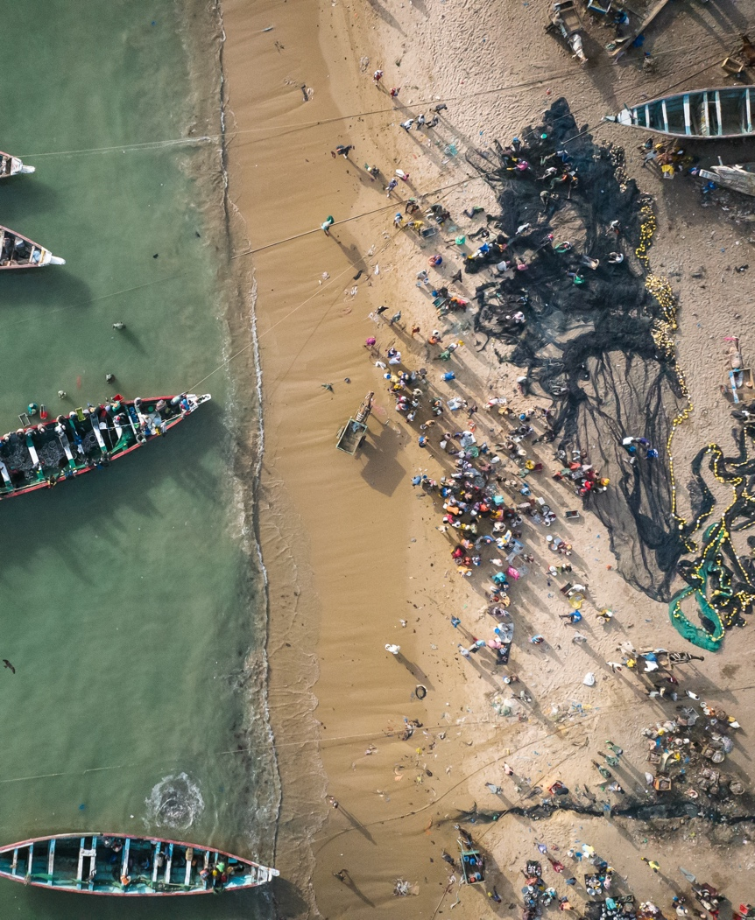
The Environmental Justice Foundation (EJF) exists to protect the natural world and to defend our basic human right to a safe environment.
EJF works internationally to promote systemic and lasting reforms that safeguard the environment and defend human rights.
We investigate and expose abuses, and we support environmental defenders.
Our campaigns aim to ensure a peaceful, equitable, and sustainable future.
Notes:
¿Cómo hacemos eso?
Realizamos investigaciones, documentales e informes exponiendo abusos de derechos humanos y del medioambiente, muy a menudo interrelacionados.
Con los que informamos a diversas partes interesadas como gobiernos, legisladores, organizaciones internacionales o empresas.
Con el objetivo último de promover cambios sistémicos que protejan a las personas y al planeta.
How do we do that? We conduct investigations, documentaries, and reports exposing human rights and environmental abuses, which are often interconnected.
We use this information to inform various stakeholders, including governments, legislators, international organizations, and businesses.
Our ultimate goal is to drive systemic change that protects both people and the planet.

Slide 3
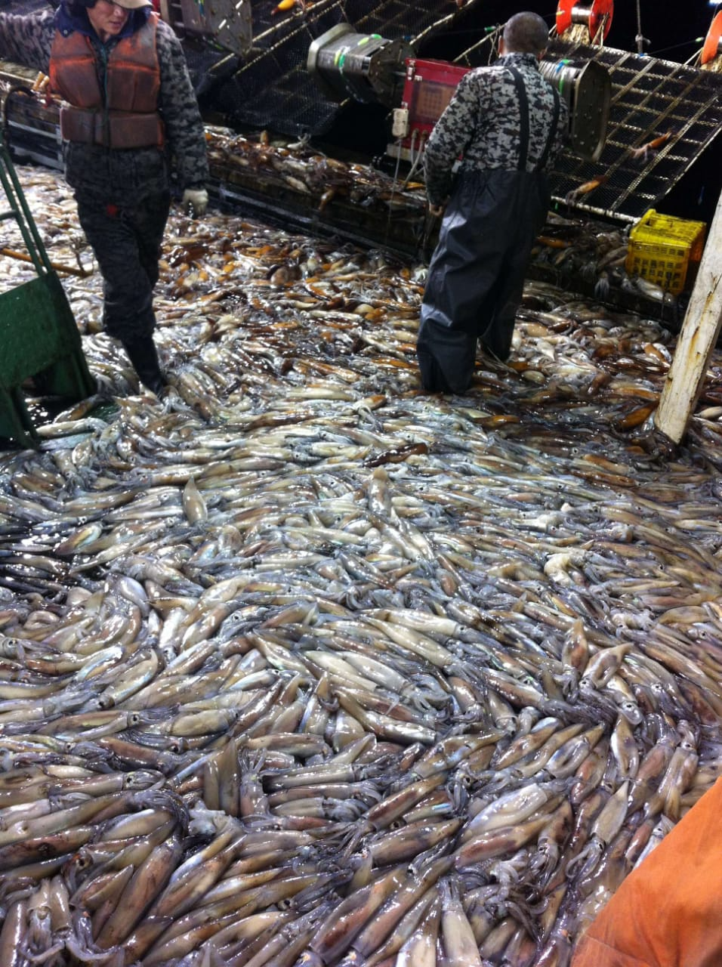
INDEX
Brief global context
Expedition to the Southwest Atlantic
Lack of regulation
Overexploitation
Human rights abuses
Environmental abuses
EU and Argentine shortfin squid
Key market
Imports linked to abuses
Uneven level playing field
Conclusions
Recommendations
Argentine shortfin squid in a squid fishing vessel in the Southwest Atlantic
Notes:
Organización internacional que opera a nivel internacional, en más de 16 países y cuatro continentes (Bélgica, Brasil, Camerún, Francia, Alemania, Ghana, Indonesia, Liberia, Senegal, Corea del Sur, España, Taiwán, Tailandia, Filipinas, Japón y Reino Unido)
Trabajamos en muchos ámbitos diferentes, desde deforestación, cambio climático, protección de la biodiversidad.
EJF tiene un gran componente de trabajo en océanos:
Pesca ilegal, no declarada y no reglamentada (INDNR)
Áreas Marinas Protegidas
Minería en aguas profundas
Pesca de arrastre
Contaminación por plásticos
An international organization operating in more than 16 countries across four continents (Belgium, Brazil, Cameroon, France, Germany, Ghana, Indonesia, Liberia, Senegal, South Korea, Spain, Taiwan, Thailand, the Philippines, Japan, and the United Kingdom).
We work across various areas, including deforestation, climate change, and biodiversity protection.
EJF has a strong focus on ocean-related issues, including:
Illegal, unreported, and unregulated (IUU) fishing
Marine Protected Areas
Deep-sea mining
Bottom trawling
Plastic pollution

Slide 4
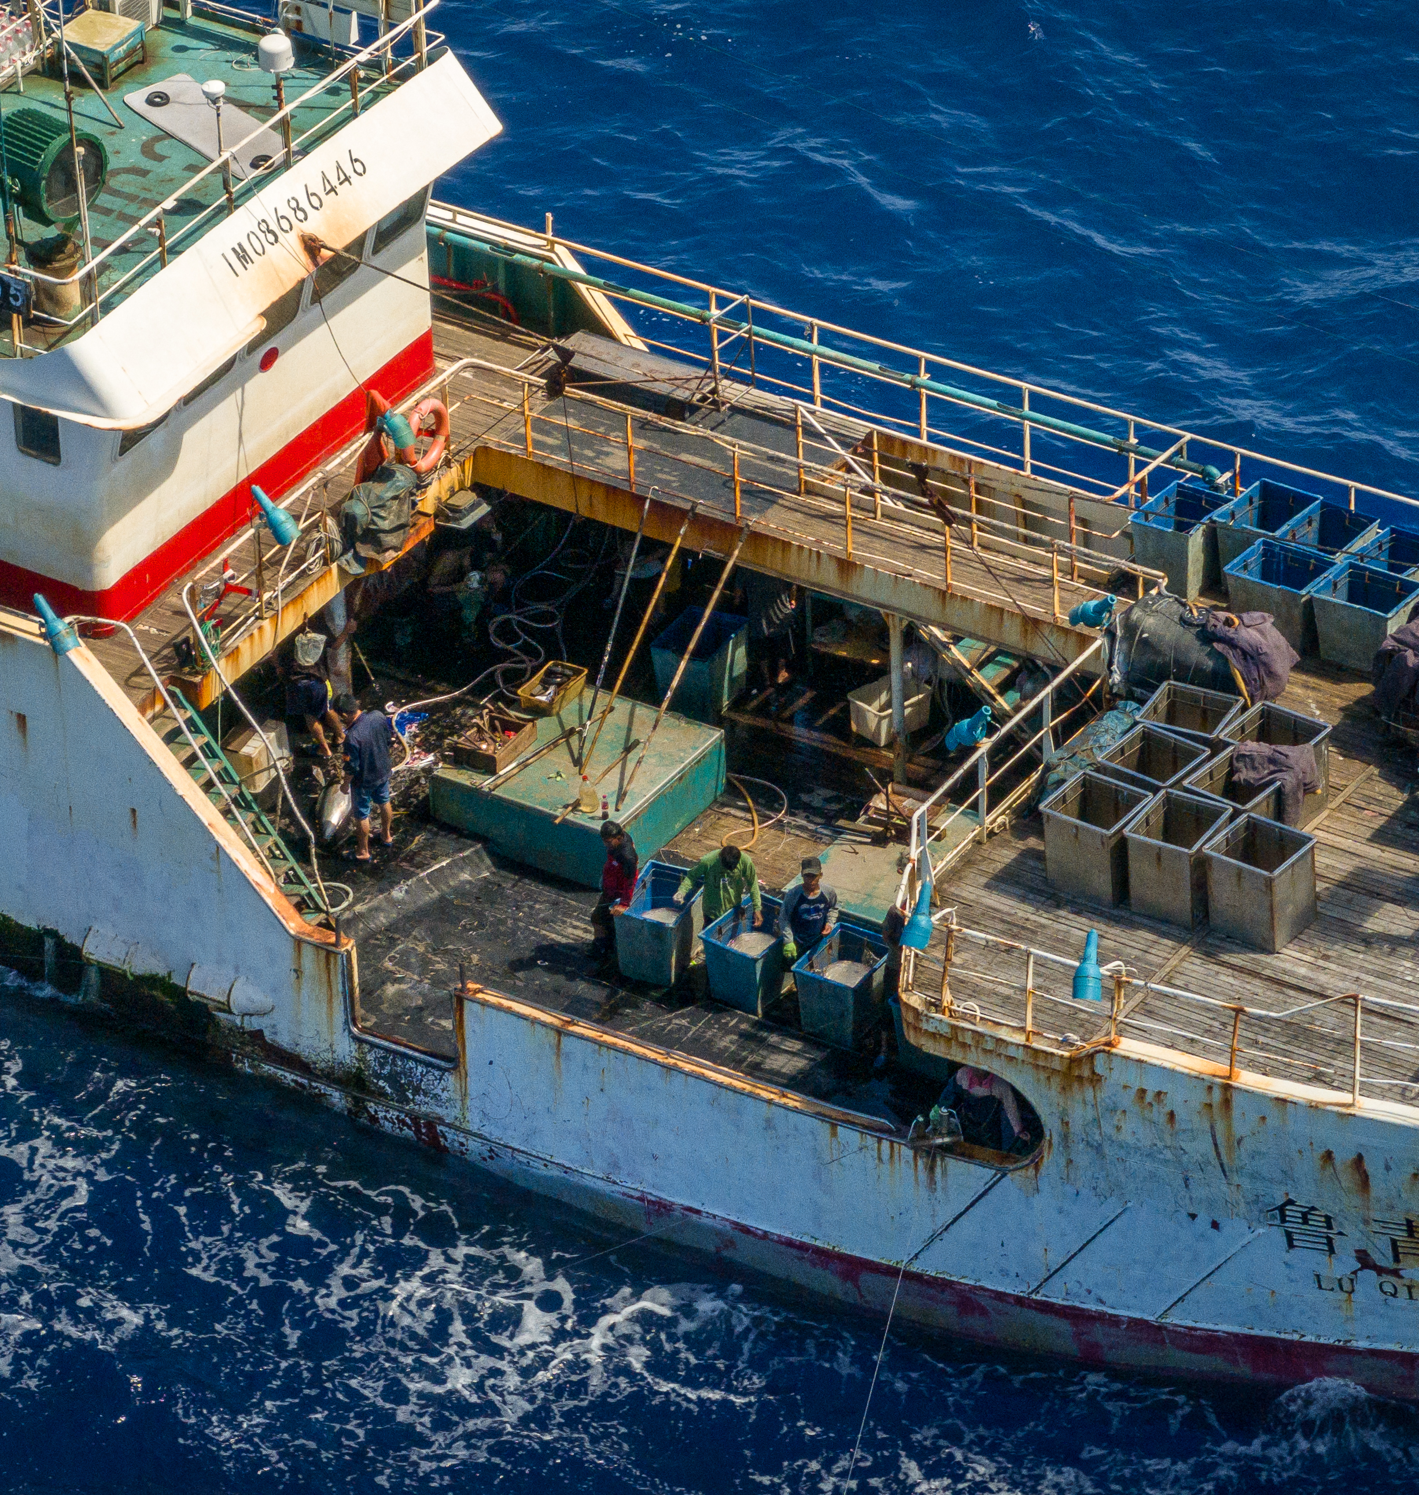
Brief global context
2017 – 2020: 70% increase in global fishing effort on squid:
Demand increase
Expansion of distant water fleets
Depletion of certain commercial finfish populations
Fishing vessel in the Indian ocean
Notes:
Organización internacional que opera a nivel internacional, en más de 16 países y cuatro continentes (Bélgica, Brasil, Camerún, Francia, Alemania, Ghana, Indonesia, Liberia, Senegal, Corea del Sur, España, Taiwán, Tailandia, Filipinas, Japón y Reino Unido)
Trabajamos en muchos ámbitos diferentes, desde deforestación, cambio climático, protección de la biodiversidad.
EJF tiene un gran componente de trabajo en océanos:
Pesca ilegal, no declarada y no reglamentada (INDNR)
Áreas Marinas Protegidas
Minería en aguas profundas
Pesca de arrastre
Contaminación por plásticos
An international organization operating in more than 16 countries across four continents (Belgium, Brazil, Cameroon, France, Germany, Ghana, Indonesia, Liberia, Senegal, South Korea, Spain, Taiwan, Thailand, the Philippines, Japan, and the United Kingdom).
We work across various areas, including deforestation, climate change, and biodiversity protection.
EJF has a strong focus on ocean-related issues, including:
Illegal, unreported, and unregulated (IUU) fishing
Marine Protected Areas
Deep-sea mining
Bottom trawling
Plastic pollution

Slide 5
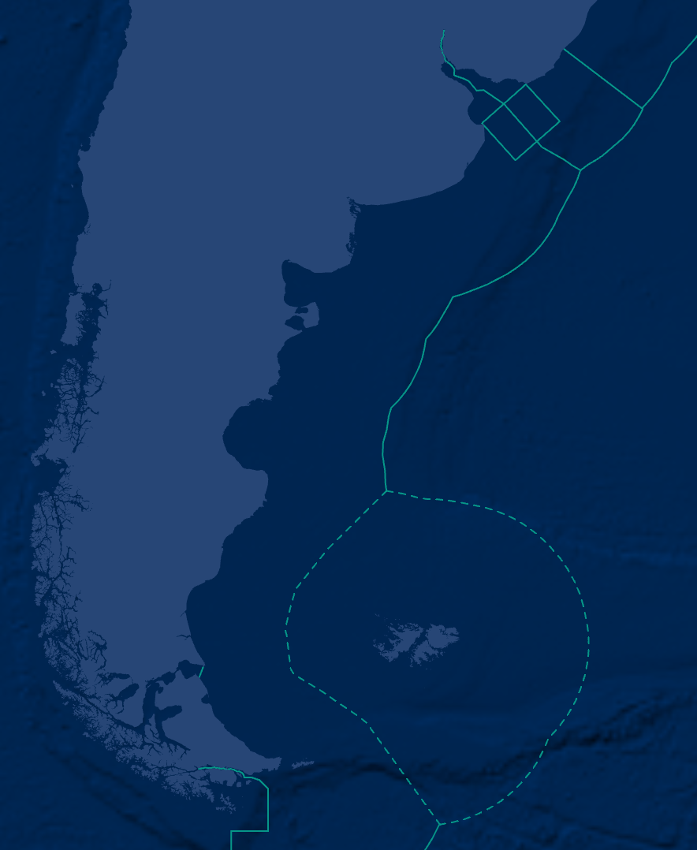
Brief global context
Around 86% of fishing effort on squid is not regulated:
High seas
Fisheries not subjected to management (e.g., RFMO)
International waters of the Atlantic Southwest:
No fisheries management or international cooperation
Lack of information and transparency
Notes:
Organización internacional que opera a nivel internacional, en más de 16 países y cuatro continentes (Bélgica, Brasil, Camerún, Francia, Alemania, Ghana, Indonesia, Liberia, Senegal, Corea del Sur, España, Taiwán, Tailandia, Filipinas, Japón y Reino Unido)
Trabajamos en muchos ámbitos diferentes, desde deforestación, cambio climático, protección de la biodiversidad.
EJF tiene un gran componente de trabajo en océanos:
Pesca ilegal, no declarada y no reglamentada (INDNR)
Áreas Marinas Protegidas
Minería en aguas profundas
Pesca de arrastre
Contaminación por plásticos
An international organization operating in more than 16 countries across four continents (Belgium, Brazil, Cameroon, France, Germany, Ghana, Indonesia, Liberia, Senegal, South Korea, Spain, Taiwan, Thailand, the Philippines, Japan, and the United Kingdom).
We work across various areas, including deforestation, climate change, and biodiversity protection.
EJF has a strong focus on ocean-related issues, including:
Illegal, unreported, and unregulated (IUU) fishing
Marine Protected Areas
Deep-sea mining
Bottom trawling
Plastic pollution

Slide 6
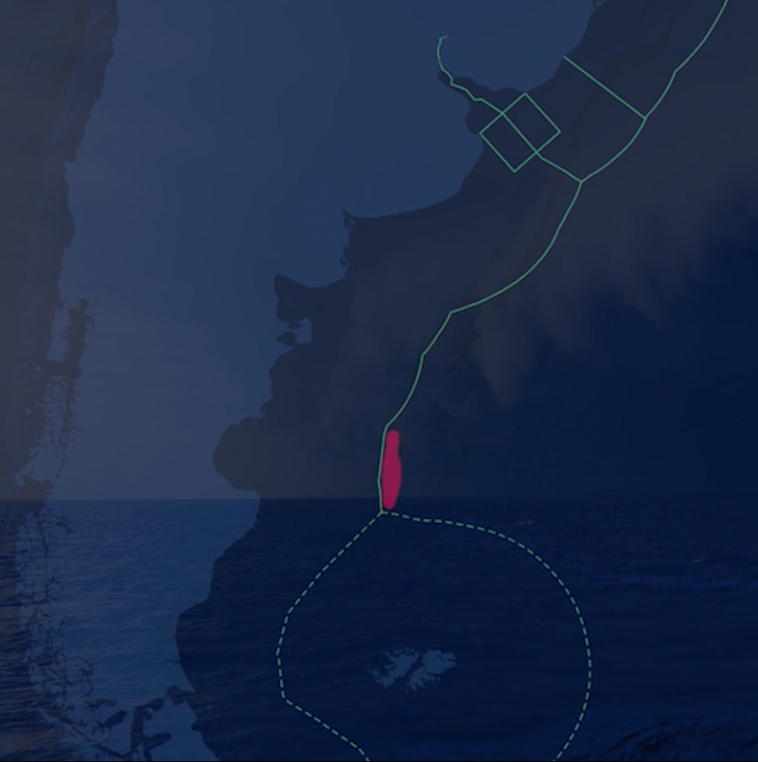
Methodology:
Expedition to the ‘Mile 201’ with the Argentine Coast Guard (Feb – Mar 2025)
Testimonies
169 crew members of squid fishing vessels operating in the area
Scientists of the Argentinian government (INIDEP)
Members of the Coast Guard
Public information
Websites (p. ej., TradedataPro, UNCOMTRADE, Eurostat, FAOFishStat)
Scientific publications and reports from governments and institutions
Satellite data
AIS data from Global Fishing Watch
The ‘Mile 201’ in the adjacent waters of the Argentinian EEZ
Notes:
The information used in this report is based on three main sources - publicly disclosed information, testimony and images from crew, and satellite data.
Public information was gathered from websites including maritime database Sea-web, shipment record database Panjiva, and the two IPO prospectuses published by ZOF. Trade-related information has also been obtained from public records available by many of the importing countries ZOF trades with.
The testimony of 20 crewmembers was gathered by EJF’s investigators in Indonesia, the most common home country of migrant workers on many key distant water fishing (DWF) fleets.
In order to corroborate information provided by crewmembers, identify suspected instances of trans-shipment at sea and to track vessel movements including visits to port, EJF used satellite-based tracking systems (Global Fishing Watch and Starboard) which allow for the observation of vessels equipped with AIS transponders

Slide 7
Results:
Every year, around 343 squid fishing vessels arrive at the Mile 201
Target: Argentine shortfin squid (illex argentinus)
Vessels from China (75%), Taiwan (18%) and South Korea(7%)
91% of the fishing effort from Chinese vessels
65% increase in fishing hours between 2019 and 2024
85% increase in the case of China
The ‘Mile 201’ in the adjacent waters of the Argentinian EEZ
Notes:
The information used in this report is based on three main sources - publicly disclosed information, testimony and images from crew, and satellite data.
Public information was gathered from websites including maritime database Sea-web, shipment record database Panjiva, and the two IPO prospectuses published by ZOF. Trade-related information has also been obtained from public records available by many of the importing countries ZOF trades with.
The testimony of 20 crewmembers was gathered by EJF’s investigators in Indonesia, the most common home country of migrant workers on many key distant water fishing (DWF) fleets.
In order to corroborate information provided by crewmembers, identify suspected instances of trans-shipment at sea and to track vessel movements including visits to port, EJF used satellite-based tracking systems (Global Fishing Watch and Starboard) which allow for the observation of vessels equipped with AIS transponders

Slide 8
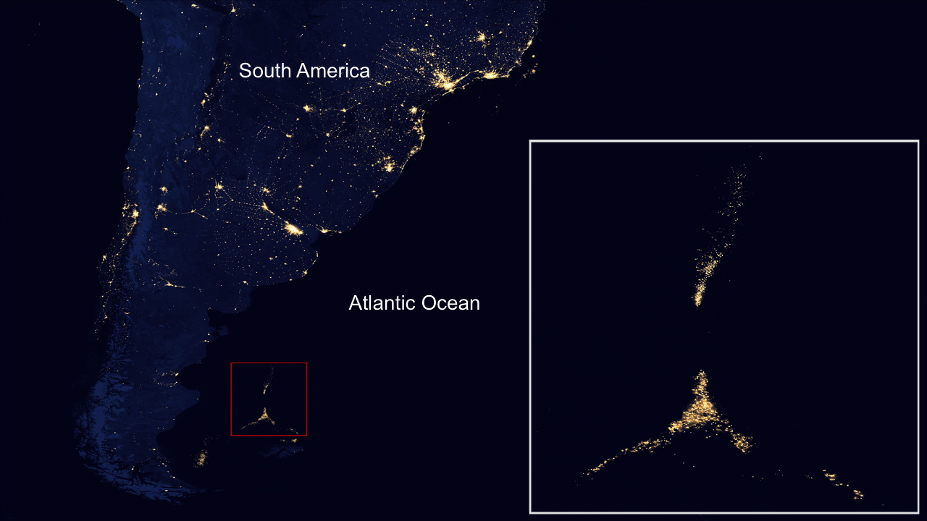
Notes:
The information used in this report is based on three main sources - publicly disclosed information, testimony and images from crew, and satellite data.
Public information was gathered from websites including maritime database Sea-web, shipment record database Panjiva, and the two IPO prospectuses published by ZOF. Trade-related information has also been obtained from public records available by many of the importing countries ZOF trades with.
The testimony of 20 crewmembers was gathered by EJF’s investigators in Indonesia, the most common home country of migrant workers on many key distant water fishing (DWF) fleets.
In order to corroborate information provided by crewmembers, identify suspected instances of trans-shipment at sea and to track vessel movements including visits to port, EJF used satellite-based tracking systems (Global Fishing Watch and Starboard) which allow for the observation of vessels equipped with AIS transponders

Slide 9
Results:
Argentine shortfin squid:
Transzonal species between Argentina’s EEZ and the high seas
Short life cycle (1 year)
Sensitive to environmental conditions and overfishing
 | EEZ of Argentina | High seas
Squid vessels | 70 approx. | 343 approx.
Resource management | Yes | No
Control | INIDEP, Coast Guard
The ‘Mile 201’ in the adjacent waters of the Argentinian EEZ
Notes:
The information used in this report is based on three main sources - publicly disclosed information, testimony and images from crew, and satellite data.
Public information was gathered from websites including maritime database Sea-web, shipment record database Panjiva, and the two IPO prospectuses published by ZOF. Trade-related information has also been obtained from public records available by many of the importing countries ZOF trades with.
The testimony of 20 crewmembers was gathered by EJF’s investigators in Indonesia, the most common home country of migrant workers on many key distant water fishing (DWF) fleets.
In order to corroborate information provided by crewmembers, identify suspected instances of trans-shipment at sea and to track vessel movements including visits to port, EJF used satellite-based tracking systems (Global Fishing Watch and Starboard) which allow for the observation of vessels equipped with AIS transponders

Slide 10
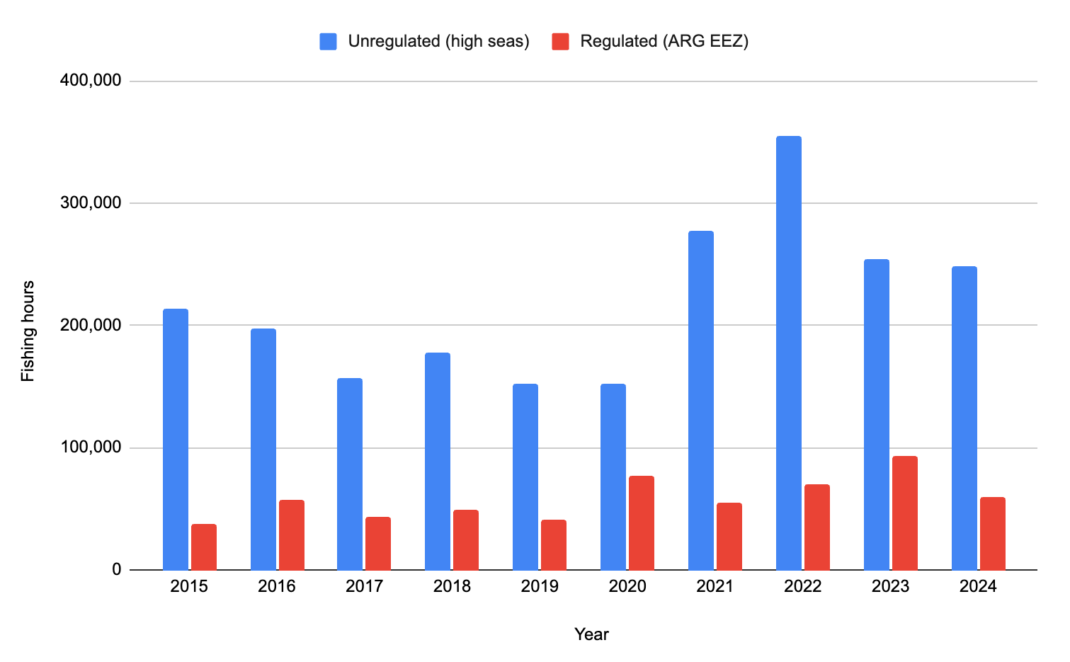
Notes:
The information used in this report is based on three main sources - publicly disclosed information, testimony and images from crew, and satellite data.
Public information was gathered from websites including maritime database Sea-web, shipment record database Panjiva, and the two IPO prospectuses published by ZOF. Trade-related information has also been obtained from public records available by many of the importing countries ZOF trades with.
The testimony of 20 crewmembers was gathered by EJF’s investigators in Indonesia, the most common home country of migrant workers on many key distant water fishing (DWF) fleets.
In order to corroborate information provided by crewmembers, identify suspected instances of trans-shipment at sea and to track vessel movements including visits to port, EJF used satellite-based tracking systems (Global Fishing Watch and Starboard) which allow for the observation of vessels equipped with AIS transponders

Slide 11
Results:
Lack of full management of the resource (ARG EEZ + high seas)
Uncontrolled fishing
Unfavourable environmental conditions
SQUID POPULATION COLLAPSE
Notes:
The information used in this report is based on three main sources - publicly disclosed information, testimony and images from crew, and satellite data.
Public information was gathered from websites including maritime database Sea-web, shipment record database Panjiva, and the two IPO prospectuses published by ZOF. Trade-related information has also been obtained from public records available by many of the importing countries ZOF trades with.
The testimony of 20 crewmembers was gathered by EJF’s investigators in Indonesia, the most common home country of migrant workers on many key distant water fishing (DWF) fleets.
In order to corroborate information provided by crewmembers, identify suspected instances of trans-shipment at sea and to track vessel movements including visits to port, EJF used satellite-based tracking systems (Global Fishing Watch and Starboard) which allow for the observation of vessels equipped with AIS transponders

Slide 12
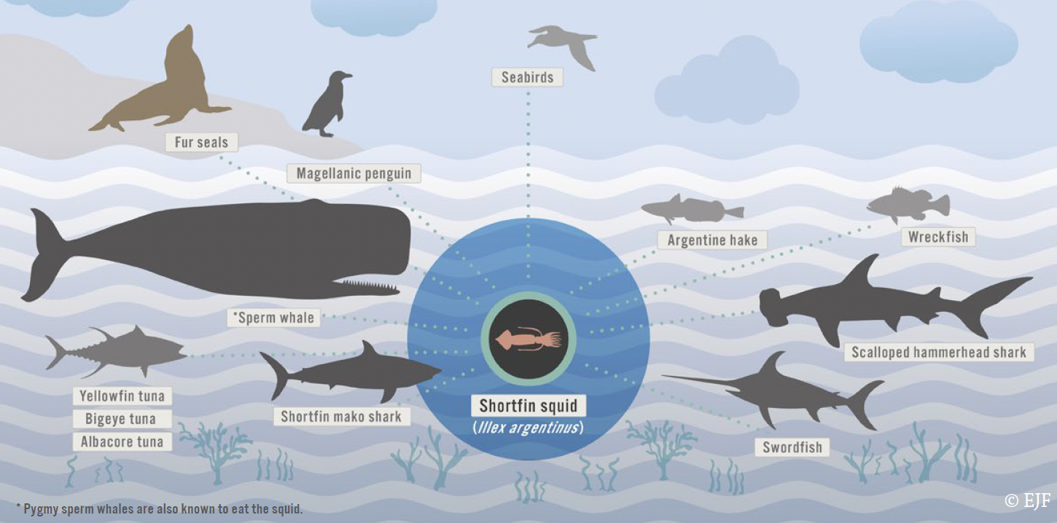
Notes:
The information used in this report is based on three main sources - publicly disclosed information, testimony and images from crew, and satellite data.
Public information was gathered from websites including maritime database Sea-web, shipment record database Panjiva, and the two IPO prospectuses published by ZOF. Trade-related information has also been obtained from public records available by many of the importing countries ZOF trades with.
The testimony of 20 crewmembers was gathered by EJF’s investigators in Indonesia, the most common home country of migrant workers on many key distant water fishing (DWF) fleets.
In order to corroborate information provided by crewmembers, identify suspected instances of trans-shipment at sea and to track vessel movements including visits to port, EJF used satellite-based tracking systems (Global Fishing Watch and Starboard) which allow for the observation of vessels equipped with AIS transponders

Slide 13
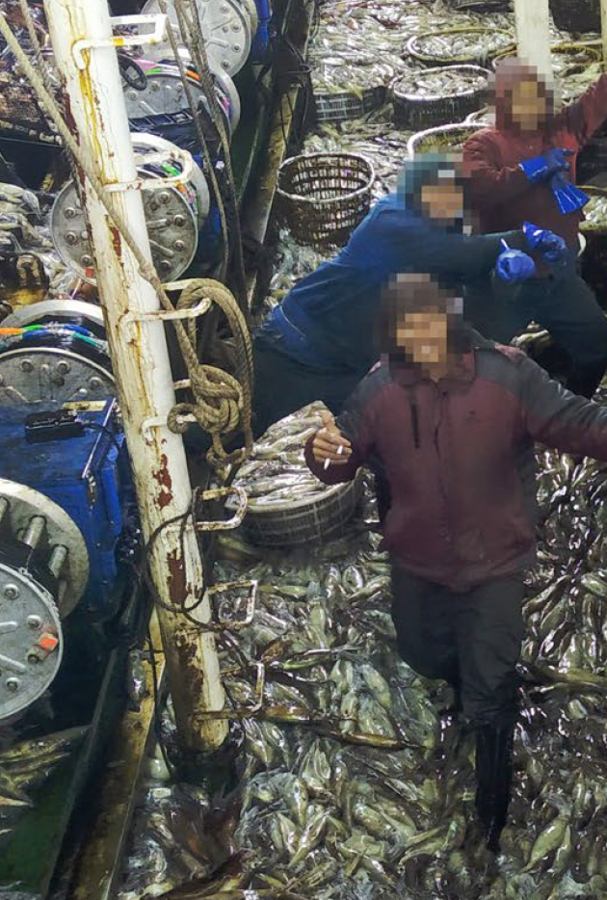
Abuses :
Testimonies from 169 crew members
Covering 20% of the fleet (110 squid jiggers)
Indonesia (98%) and the Philippines (2%)
2019 – 2024
Serious and generalised human rights and labour abuses
Deaths of 5 crew members on board 4 Chinese vessels
Physical violence, intimidation, salary retentions, deplorable working conditions, etc.
Crew members on a squid jigging vessel in the Atlantic Southwest
Notes:
The information used in this report is based on three main sources - publicly disclosed information, testimony and images from crew, and satellite data.
Public information was gathered from websites including maritime database Sea-web, shipment record database Panjiva, and the two IPO prospectuses published by ZOF. Trade-related information has also been obtained from public records available by many of the importing countries ZOF trades with.
The testimony of 20 crewmembers was gathered by EJF’s investigators in Indonesia, the most common home country of migrant workers on many key distant water fishing (DWF) fleets.
In order to corroborate information provided by crewmembers, identify suspected instances of trans-shipment at sea and to track vessel movements including visits to port, EJF used satellite-based tracking systems (Global Fishing Watch and Starboard) which allow for the observation of vessels equipped with AIS transponders

Slide 14
Conditions indicative of forced labour reported by crew members working on board the high seas squid jigging fleet operating in the Southwest Atlantic
Indicator of forced labour (ILO) | % of crew interviewed on Chinese vessels (n=56) | % of crew interviewed on South Korean vessels (n=57) | % of crew interviewed on Taiwanese vessels (n=56)
Abuse of vulnerability | 14,3% | 1,8% | 7,1%
Deception | 78,6% | 22,8% | 55,4%
Physical violence | 50% | 8,8% | 21,4%
Intimidation and threats | 48,2% | 28,1% | 37,5%
Retention of ID documents | 94,6% | 87,7% | 91,1%
Withholding of wages | 57,1% | 7% | 19,6%
Debt bondage | 94,6% | 64,9% | 83,9%
Abusive working and living conditions | 76,8% | 8,8% | 33,9%
Excessive overtime | 83,9% | 82,5% | 87,5%
Notes:
The information used in this report is based on three main sources - publicly disclosed information, testimony and images from crew, and satellite data.
Public information was gathered from websites including maritime database Sea-web, shipment record database Panjiva, and the two IPO prospectuses published by ZOF. Trade-related information has also been obtained from public records available by many of the importing countries ZOF trades with.
The testimony of 20 crewmembers was gathered by EJF’s investigators in Indonesia, the most common home country of migrant workers on many key distant water fishing (DWF) fleets.
In order to corroborate information provided by crewmembers, identify suspected instances of trans-shipment at sea and to track vessel movements including visits to port, EJF used satellite-based tracking systems (Global Fishing Watch and Starboard) which allow for the observation of vessels equipped with AIS transponders

Slide 15
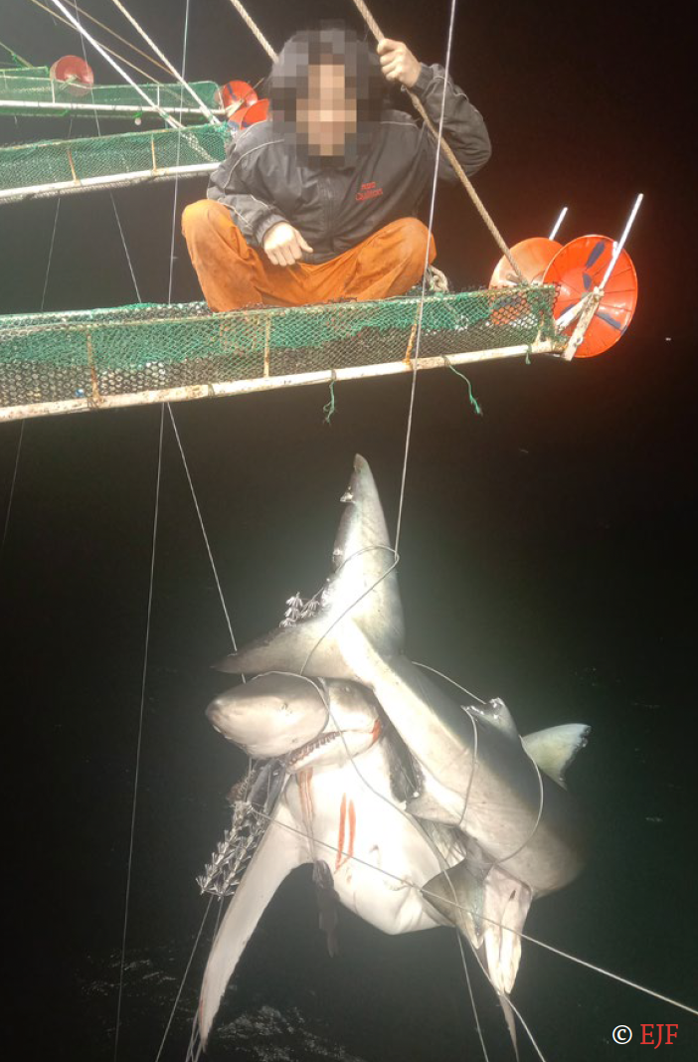
Abuses :
Testimonies from 169 crew members
Covering 20% of the fleet (110 squid jiggers)
Indonesia (98%) and the Philippines (2%)
2019 – 2024
Environmental abuses:
Obscuring vessel identification numbers and names
Shark finning
Capture of charismatic megafauna
A shark entangled in a jigging line in a squid jigging vessel in the Atlantic Southwest
Notes:
The information used in this report is based on three main sources - publicly disclosed information, testimony and images from crew, and satellite data.
Public information was gathered from websites including maritime database Sea-web, shipment record database Panjiva, and the two IPO prospectuses published by ZOF. Trade-related information has also been obtained from public records available by many of the importing countries ZOF trades with.
The testimony of 20 crewmembers was gathered by EJF’s investigators in Indonesia, the most common home country of migrant workers on many key distant water fishing (DWF) fleets.
In order to corroborate information provided by crewmembers, identify suspected instances of trans-shipment at sea and to track vessel movements including visits to port, EJF used satellite-based tracking systems (Global Fishing Watch and Starboard) which allow for the observation of vessels equipped with AIS transponders

Slide 16
Overview of alleged illegal fishing and harm to marine wildlife reported by crew members
 | % Chinese squid jigging fleet at Mile 201 covered by interviews | % South Korean squid jigging fleet at Mile 201 covered by interviews | % Taiwanese squid jigging fleet at Mile 201 covered by interviews
Changing or covering vessel names/ numbers | 19,6% | 0,0% | 0,0%
Harpooning of seals | 43,5% | 4% | 20,5%
Shark finning | 26% | 0,0% | 5,1%
“[It happened] often. If the seals got close to the vessel, the vessel would harpoon them. After the seals were brought on board, the teeth were pulled. The vice [captain] took the teeth and genitalia. Sometimes he also took the body and skin – but the (bodies) were often discarded.”
Crew member working on board a Chinese squid jigger, interviewed by EJF in September 2021
Notes:
The information used in this report is based on three main sources - publicly disclosed information, testimony and images from crew, and satellite data.
Public information was gathered from websites including maritime database Sea-web, shipment record database Panjiva, and the two IPO prospectuses published by ZOF. Trade-related information has also been obtained from public records available by many of the importing countries ZOF trades with.
The testimony of 20 crewmembers was gathered by EJF’s investigators in Indonesia, the most common home country of migrant workers on many key distant water fishing (DWF) fleets.
In order to corroborate information provided by crewmembers, identify suspected instances of trans-shipment at sea and to track vessel movements including visits to port, EJF used satellite-based tracking systems (Global Fishing Watch and Starboard) which allow for the observation of vessels equipped with AIS transponders

Slide 17
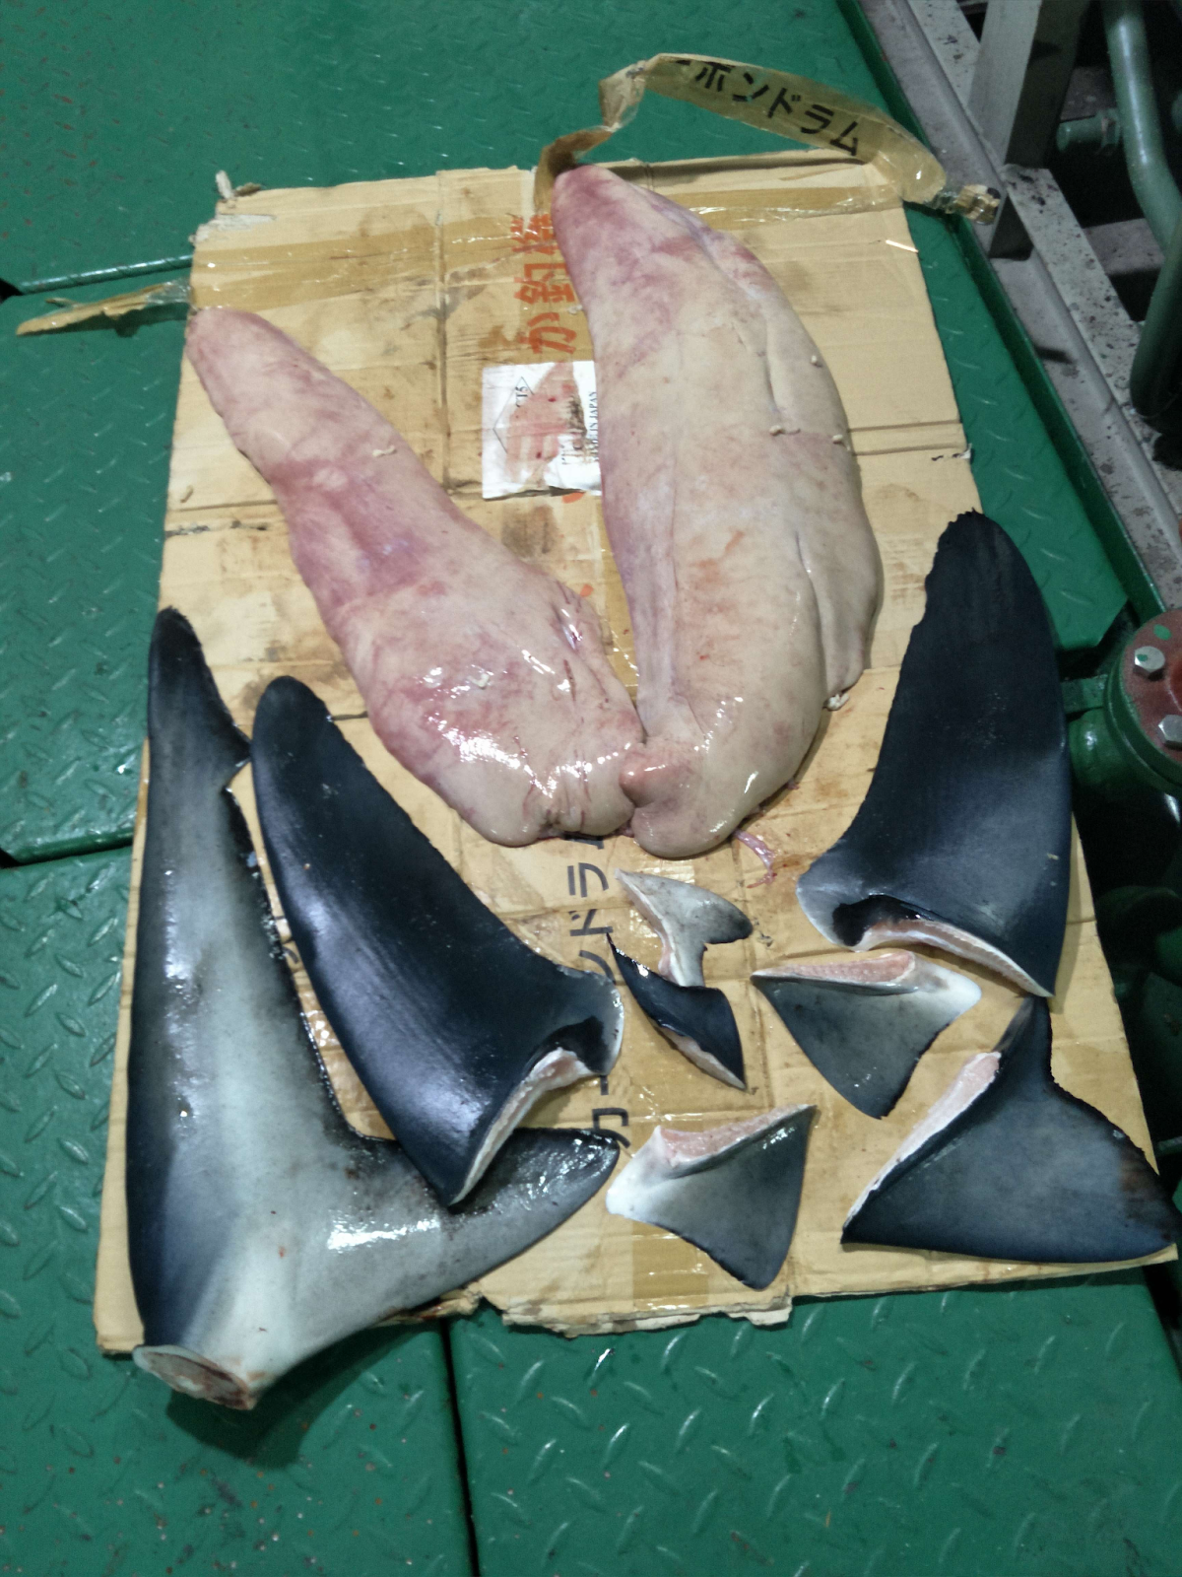
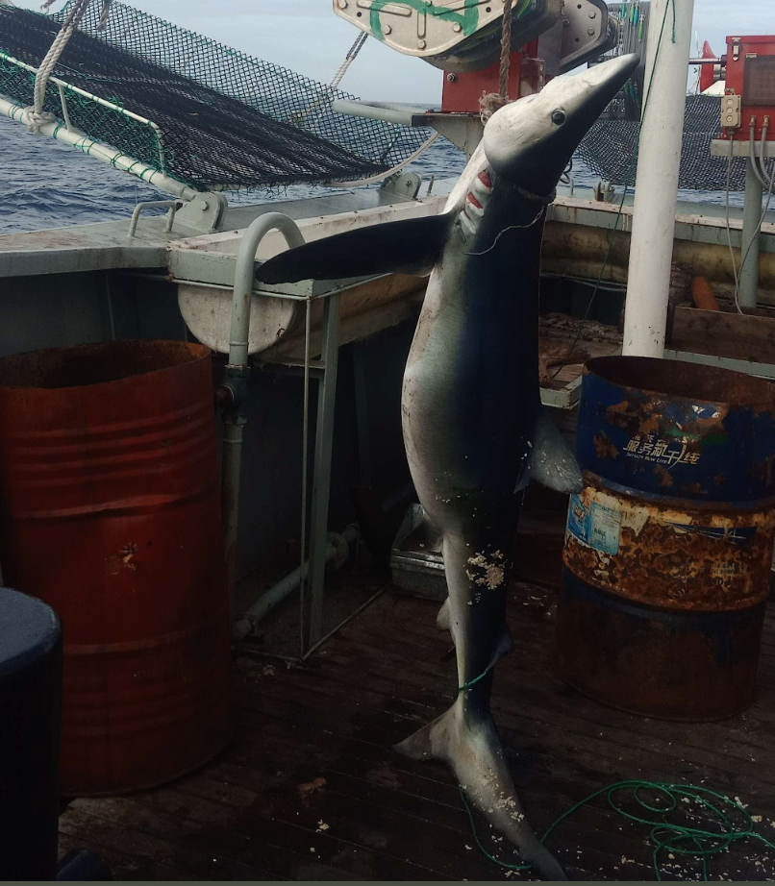
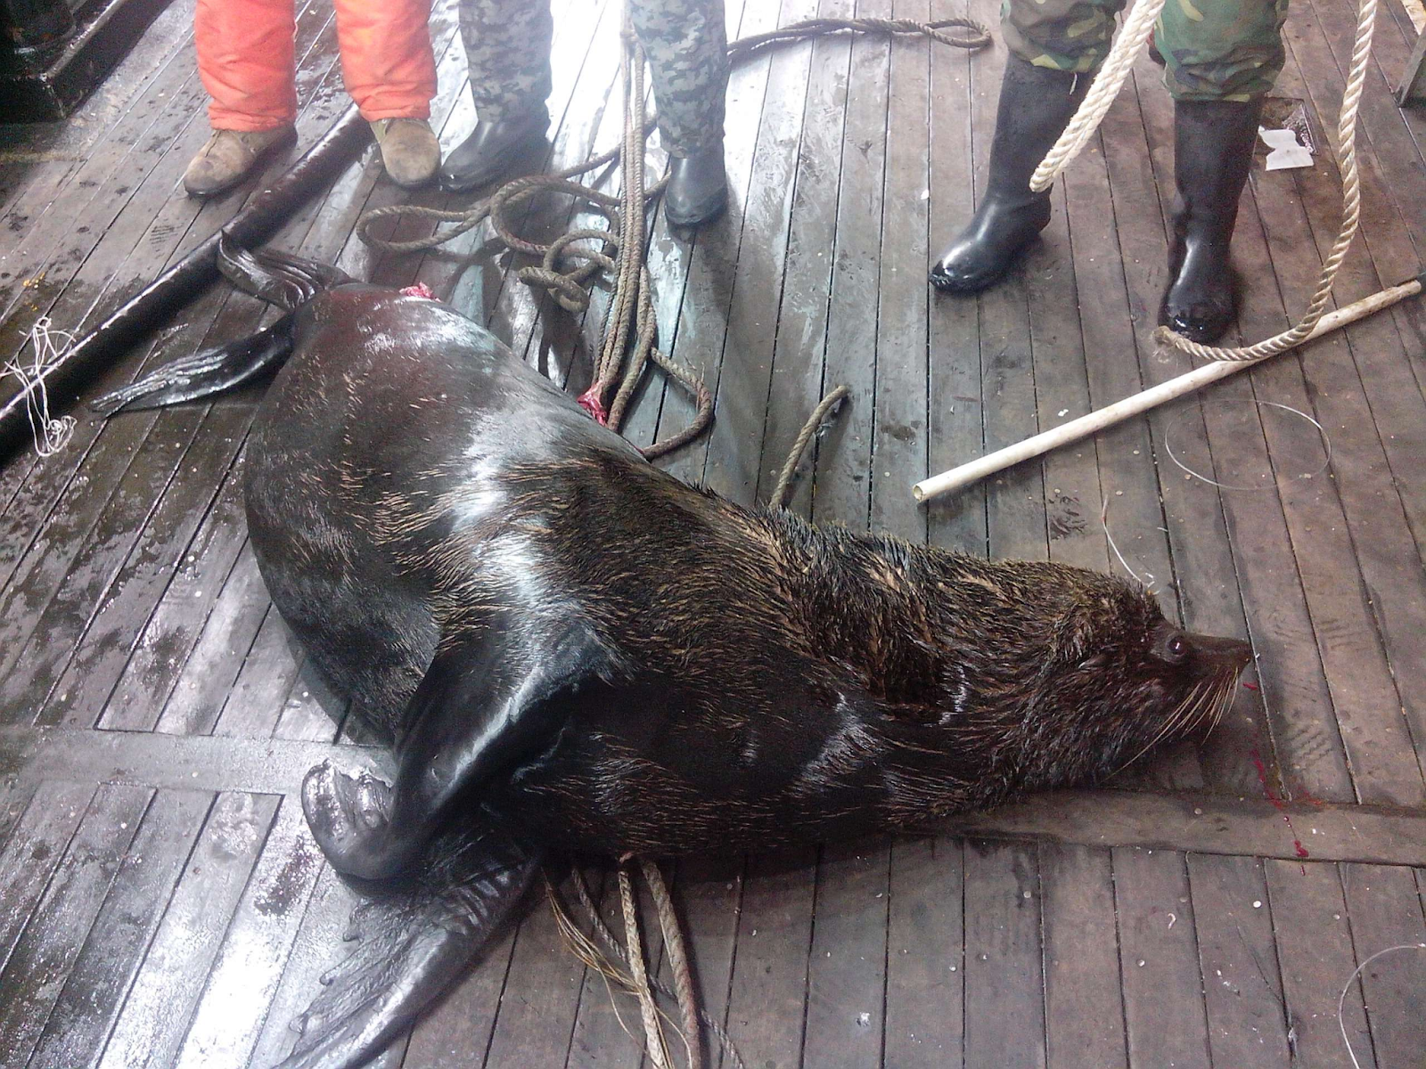

Notes:
Explanation of the graph

Slide 18
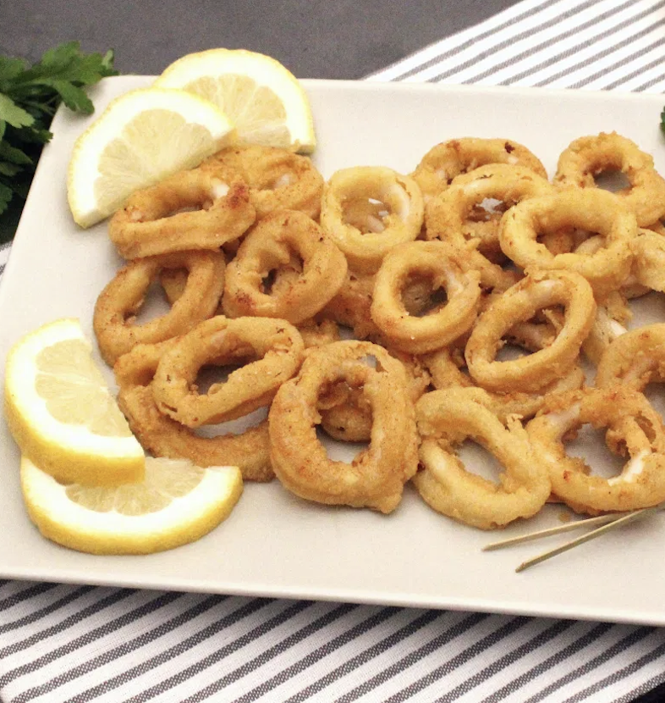
What about the EU?
Notes:
Explanation of the graph

Slide 19
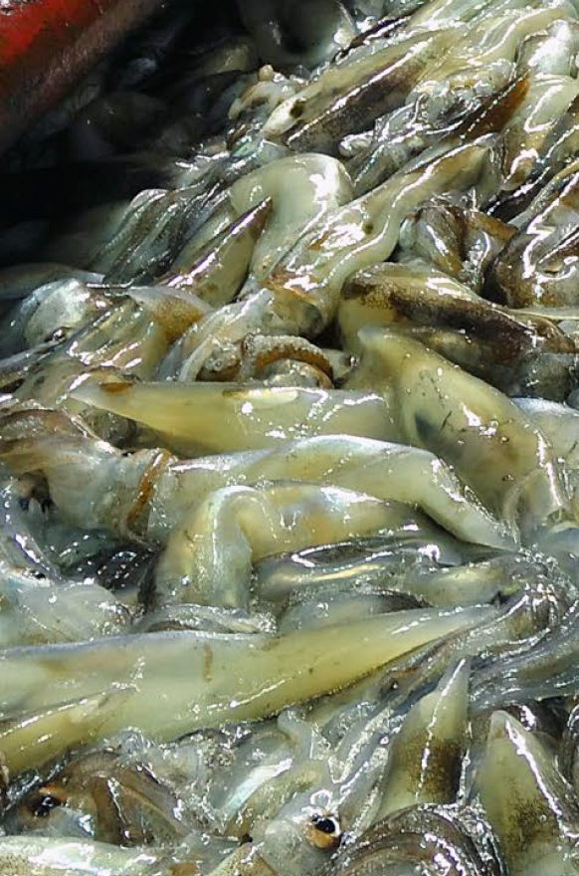
A key market state globally
Spain alone is the second biggest importer of squid and cuttlefish worldwide (15%), after China
National consumption: 85% imported
The EU’s gateway: 65% of all imported squid enters via Spain.
Squid catches on board a squid jigging vessel in the Atlantic Southwest
Notes:
Nowadays, ZOF is privately owned by a Chinese conglomerate, Wanxiang Sannong Group
Chinese state-owned companies still maintain a partial and indirect interest in ZOF, as 23.5% of the shares of Wanxiang Trust remain held by state-owned companies.
In addition, between 2018 and 2020, ZOF received governmental subsidies amounting to USD 41.7 million

Slide 20
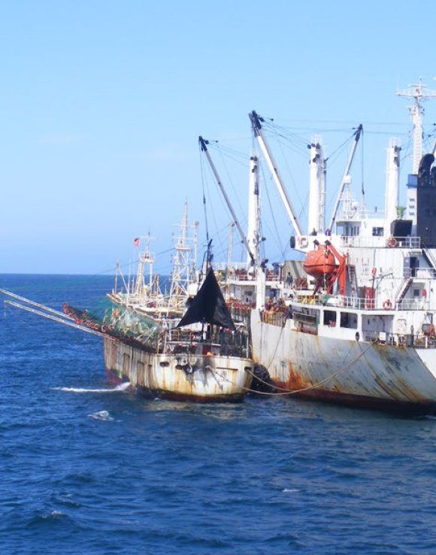
A key market state globally
Argentine shortfin squid represents 13.3% of all Spanish squid imports
From China (41%), Argentina (39%), Taiwan (12%) and Islas Malvinas/Falklands) (7%)
42.9% from unregulated areas (Mile 201)
Squid jigging vessels carrying out transhipments at sea in the Atlantic Southwest
Notes:
Nowadays, ZOF is privately owned by a Chinese conglomerate, Wanxiang Sannong Group
Chinese state-owned companies still maintain a partial and indirect interest in ZOF, as 23.5% of the shares of Wanxiang Trust remain held by state-owned companies.
In addition, between 2018 and 2020, ZOF received governmental subsidies amounting to USD 41.7 million

Slide 21
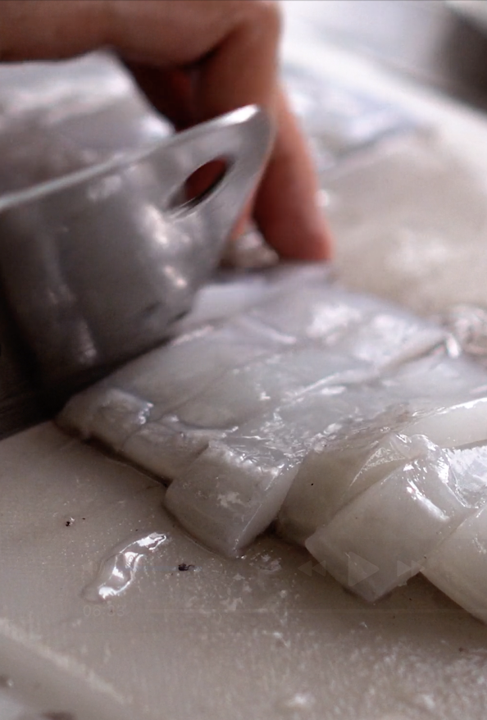
A key market state globally
47 Spanish importers bought through intermediaries from
5 Chinese companies implicated in abuses and fishing in the Southwest Atlantic
10.825 tonnes between 2019 and 2024 (9% of Spanish imports of shortfin squid throughout the period)
Entry points: Valencia (45%), Vigo (27%), Bilbao (10%), Algeciras (9%), and Barcelona (2%)
Notes:
Nowadays, ZOF is privately owned by a Chinese conglomerate, Wanxiang Sannong Group
Chinese state-owned companies still maintain a partial and indirect interest in ZOF, as 23.5% of the shares of Wanxiang Trust remain held by state-owned companies.
In addition, between 2018 and 2020, ZOF received governmental subsidies amounting to USD 41.7 million

Slide 22
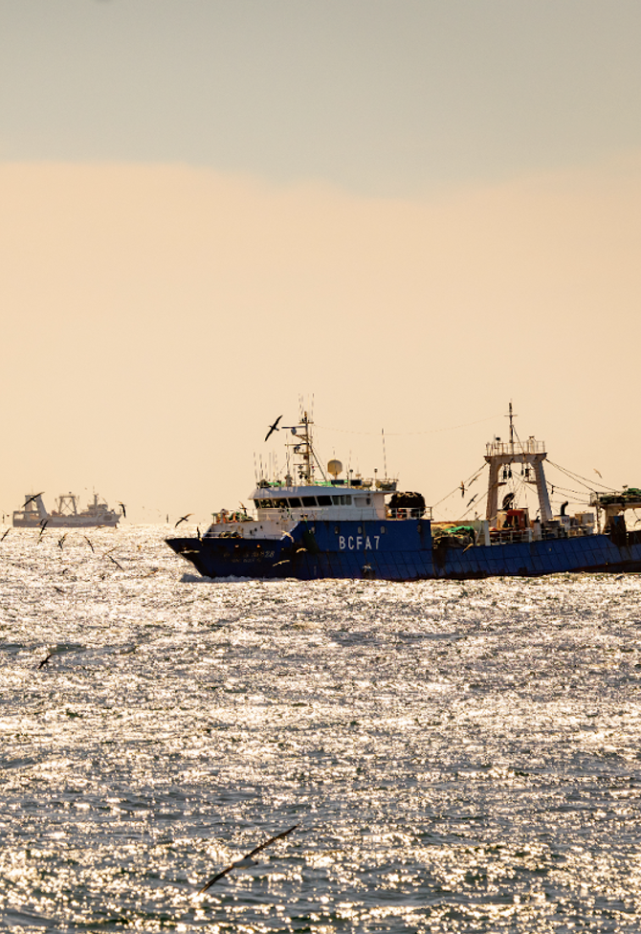
Uneven playing field
Around 30 Spanish trawlers operate at Mile 201
Squid: accessory catch
Subjected to stricter national and EU laws and standards:
Observers on board
Closure of areas for fishing
Submission of fisheries plans
Captures of the same squid stock by the EU fleet (regulated) and the Asian fleets (unregulated) compete in the same market
Trawlers operating in the high seas of the Southwest Atlantic
Notes:
Nowadays, ZOF is privately owned by a Chinese conglomerate, Wanxiang Sannong Group
Chinese state-owned companies still maintain a partial and indirect interest in ZOF, as 23.5% of the shares of Wanxiang Trust remain held by state-owned companies.
In addition, between 2018 and 2020, ZOF received governmental subsidies amounting to USD 41.7 million

Slide 23
Conclusions:
The EU’s squid supply chains are currently exposed to serious environmental and social risks
Part of them originate from unregulated fisheries linked to:
unsustainable fishing,
ecosystem degradation, and
human rights violations.
EU fishers, subject to stricter rules, risk being undermined by cheaper imports resulting from an uneven playing field.
As a key market for squid, the EU has both the influence and the responsibility to act.
Notes:
This briefing presented the potentially systematic scale of exploitation, human rights abuses and intentional wildlife killing conducted by the ZOF fleet, and the fleet’s links to the global market
The findings also show a worrying lack of monitoring from state governments and insufficient traceability of the global seafood supply chain to avoid trading and consuming products associated with such abuses
Port inspections and import controls from port states and market states are also critical to deter and detain seafood associated with illegal and unethical activities
Transparency is an immediately available and economically feasible tool to facilitate law enforcement and enable meaningful due diligence throughout the entire seafood supply chain from flag state to end buyers

Slide 24
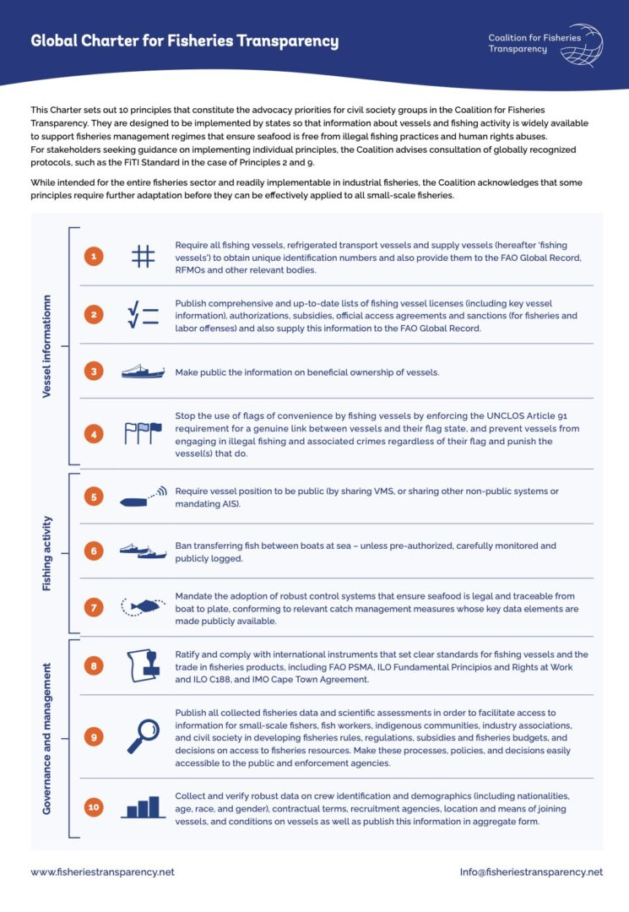
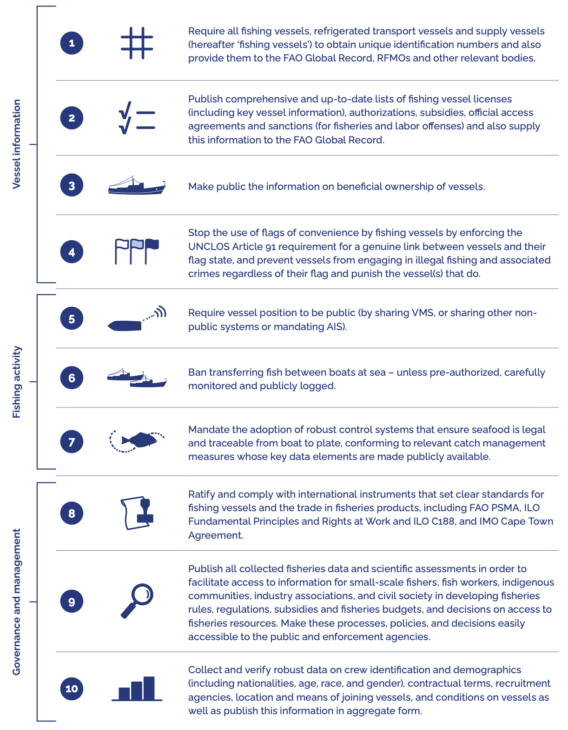
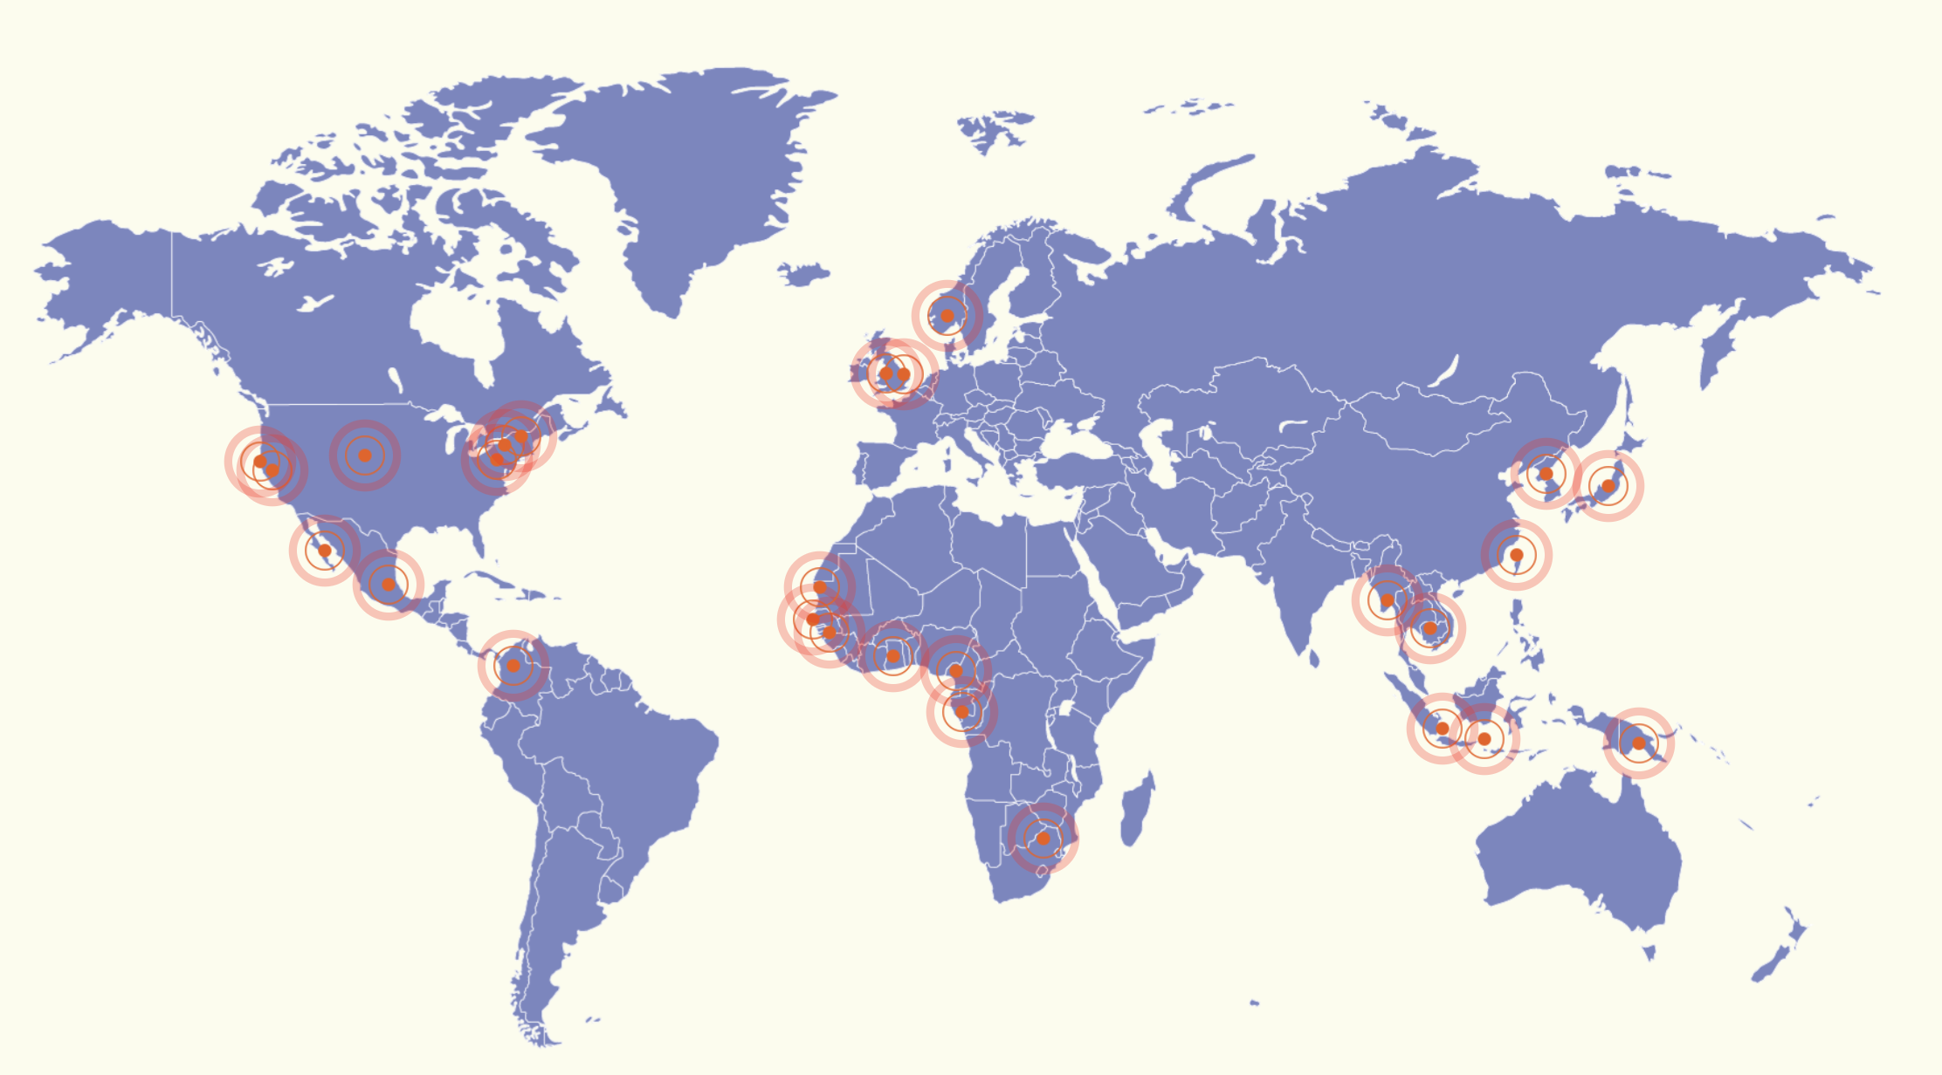
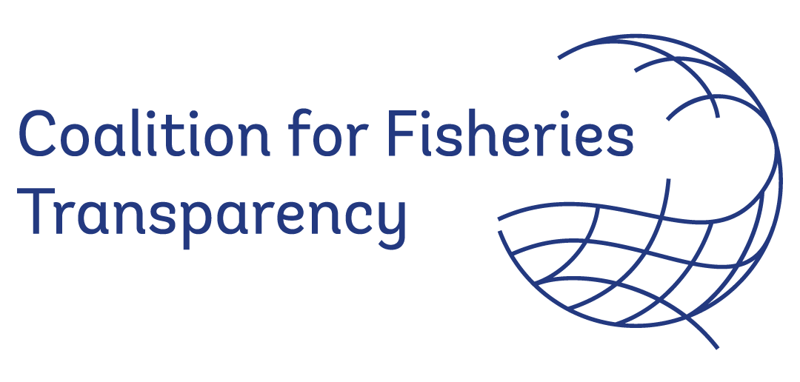
Recommendations:
To all coastal and Flag States, the adoption of the Global Charter for Fisheries Transparency
Notes:
The Global Charter is a set of 10 transparency policy principles that serves as a framework.
It sets out ten practical and achievable transparency principles — from publishing vessel registries, to mandating the use of vessel tracking systems, to disclosing fishing licenses and authorisations. These principles empower governments, the private sector, and civil society to detect and deter IUU fishing and associated abuses.
What makes the Charter powerful is its flexibility and actionability. It’s not a one-size-fits-all approach — it’s a roadmap that allows countries to progress in a stepwise, tailored fashion, according to their capacities.

Slide 25
Recommendations:
Reinforce existing import control mechanisms across the EU, ensuring they include squid species, such as Argentine shortfin squid, that are at high risk of being associated with forced labour and IUU fishing practices.
Push for the establishment of appropriate multilateral governance structures for the effective regional conservation and management of Argentine shortfin squid in the Southwest Atlantic

Slide 26
Thank you www.ejfoundation.org
Chinese-owned fishing vessels in Mozambique

